Slide 1
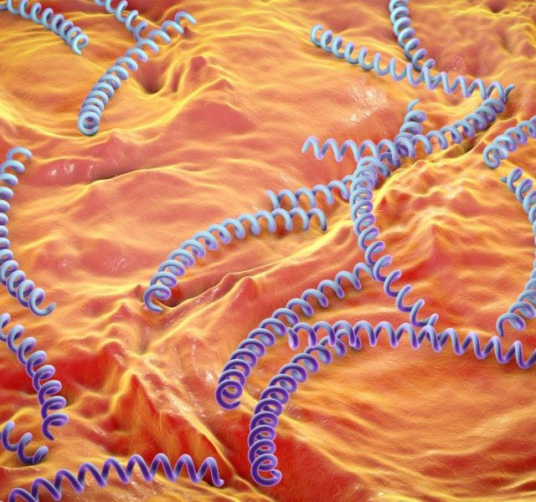
Syphilis The Great Mimic
Updated October 2017
Notes:
Syphilis is a very complex STI. It is known as the great mimic or the great imitator because in its advanced stages its symptoms can resemble those of many other diseases.
Reference:
Centers for Disease Control and Prevention, “Syphilis – CDC Fact Sheet”, http://www.cdc.gov/std/syphilis/STDFact-Syphilis.htm, accessed Jan. 2015

Slide 2
What is Syphilis?
Sexually transmitted disease caused by the bacterium Treponema pallidum
Is transmitted by direct contact with a syphilis sore during vaginal, anal, or oral sex
Time between infection and start of first symptom is 10-90 days
Diagnosed via darkfield microscopy and blood tests
Syphilis is divided into stages (primary, secondary, latent, and tertiary)
Notes:
.
Syphilis is known for mimicking many signs and symptoms of other diseases, making it indistinguishable.
Today, darkfield microscopy is rarely performed and diagnoses are more commonly made using blood tests.
References:
1. “Sexually Transmitted Diseases (STDs).” Centers for Disease Control and Prevention, Centers for Disease Control and Prevention, 13 Feb. 2017, www.cdc.gov/std/syphilis/stdfact-syphilis-detailed.htm.

Slide 3
Syphilis Trends (2016)
The total number of cases of syphilis (all stages) reported to the CDC increased 17.8% during 2015-2016 (from 74,707 cases to 88,042 cases).
A total of 27,814 cases of primary and secondary(P&S) syphilis were reported in the U.S. in 2016.
During 2015-2016, the P&S rate among women increased 35.7%.
Nationally, P&S syphilis rates increased in every age group among those aged 15 years or older and in every race/ethnicity group during 2015-2016.
.
Notes:
References:
“2016 Sexually Transmitted Diseases Surveillance.” Centers for Disease Control and Prevention, Centers for Disease Control and Prevention, 26 Sept. 2017, www.cdc.gov/std/stats16/Syphilis.htm.
.

Slide 4
Stages of Syphilis
Syphilis typically follows a progression of stages that can last for weeks, months, or even years.
Stage | Time Period | Symptoms | Location
Primary | 21 days after initial infection *heals itself in 3-6 weeks | painless ulcer, single or multiple sores | Typically occurs on genital skin and mucosa
Secondary | 4-8 weeks after primary infection ulcer appearance | Skin rash, headache, fever, fatigue, swollen lymph nodes, joint pain, loss of appetite | Rash on hands and soles of feet Sores in or around mouth, vagina, or penis Wart patches in the genitals or skin folds
Latent |  | Mostly asymptomatic, “hidden stage”- can last for years | No visible signs/symptoms- may never return or disease progresses to tertiary
- Early | 1st year of infection | Signs/symptoms usually disappear
-Late | After 1 year | Noninfectious, asymptomatic
Tertiary | 1-10years after initial infection | Damage to heart- causing aneurysms, central nervous system disorders (neurosyphilis), tumors of skin, bones, or liver | Symptoms vary and depend on which organs have been affected- can affect multiple organ systems & can be fatal
Notes:
Syphilis is a systemic disease that can affect various systems in the body and can last a lifetime. The disease progresses through 4 distinct phases: primary, secondary, latent, and tertiary. Not all infections go through all 4 stages.
The time periods shown for each stage are only an indication of the usual time because they can vary appreciably from case to case.

Slide 5
Neurosyphilis & Ocular Syphilis
Neurosyphilis is the invasion of the central nervous system (CNS).¹
can occur at any stage of syphilis infection
Symptoms include: headache, altered behavior, difficulty in muscle movement coordination, paralysis, sensory deficits, and dementia.
Ocular syphilis can involve almost any eye structure²
Can be associated with neurosyphilis and occur at any stage
Symptoms include: vision changes, decreased visual acuity, and permanent blindness
Notes:
References:
1. “Sexually Transmitted Diseases (STDs).” Centers for Disease Control and Prevention, Centers for Disease Control and Prevention, 13 Feb. 2017, www.cdc.gov/std/syphilis/stdfact-syphilis-detailed.htm.
2. “Clinical Advisory: Ocular Syphilis in the United States.” Centers for Disease Control and Prevention, Centers for Disease Control and Prevention, 3 Nov. 2016, www.cdc.gov/std/syphilis/clinicaladvisoryos2015.htm.
3. “Morbidity and Mortality Weekly Report (MMWR).” Centers for Disease Control and Prevention, Centers for Disease Control and Prevention, 17 Aug. 2017, www.cdc.gov/mmwr/volumes/65/wr/mm6543a2.htm.
4. “Neurosyphilis.” MedlinePlus Medical Encyclopedia, medlineplus.gov/ency/article/000703.htm. Accessed October 2017.
Neurosyphilis usually occurs in people who have untreated syphilis for many years. It usually occurs about 10-20 years after initial infection. Asymptomatic neurosyphilis (Most common form) occurs before symptomatic syphilis. ⁴
After ocular syphilis clusters were reported in 2015, CDC issued a clinical advisory because concerns about an increase in ocular syphilis was reviewed from eight jurisdictions (California, Florida, Indiana, Maryland, New York City, North Carolina, Texas, Washington). Overall, among total syphilis surveillance cases in the evaluated jurisdictions, 0.65% in 2015 indicated ocular symptoms. After the clinical advisory, CDC was notified of
suspected ocular syphilis cases from 20 states.³

Slide 6
How Do I Get Syphilis?
Transmission most often occurs through direct contact with a syphilis sore during vaginal, anal, or oral sex
can occur even if there is no sexual penetration
The bacteria enters the body through mucous membranes or abraded (torn or cut) skin
Syphilis enters the blood stream and attaches to cells in the body, damaging organs over time.
Most transmissions occur during the first stage because symptoms go unnoticed.
An infected pregnant woman can pass the infection to her unborn child or during childbirth.
Notes:
Syphilis is most commonly sexually transmitted, but sexual penetration or ejaculation does not need to occur for syphilis to spread, because this disease is spread via direct contact with syphilis sores in any location on the body. The bacteria (T. Pallidum) doesn’t stay confined to the are of first contact: it spreads rapidly through the body within hours of initial infection.²
References:
“Syphilis -.” Home -, www.ashasexualhealth.org/stdsstis/syphilis/.
Grimes, Jill. “Congenital Syphilis.” Sexually Transmitted Diseases: An Encyclopedia of Diseases, Prevention, Treatment, and Issues, 2:I-Z, ABC-CLIO,LLC, 2014, pp. 627-637.

Slide 7
Congenital Syphilis
With a mortality rate of 50%⁽³⁾,Congenital syphilis continues to be a concern in the U.S.¹
In 2016, the number of congenital syphilis cases was the highest it’s been since 1998.²
passed from pregnant women to their babies¹
Causes miscarriage, stillbirth, prematurity, low birth weight, or death shortly after birth²
Nearly half of all children infected with syphilis while they are in the womb die shortly before or after birth.²
80% risk of infection for untreated mother to fetus.³
Notes:
Despite the fact that this disease can be cured with antibiotics if caught early, rising rates of syphilis among pregnant women in the United States have increased the number of infants born with congenital syphilis.²
Prenatal care is very important. A routine blood test for syphilis is done during pregnancy. This identifies infected mothers so they can treated to reduce the risks to the infant and themselves. Infants born to infected mothers who received proper penicillin treatment during pregnancy are at minimal risk for congenital syphilis.²
References:
1. “Sexually Transmitted Diseases (STDs).” Centers for Disease Control and Prevention, Centers for Disease Control and Prevention, 13 Feb. 2017, www.cdc.gov/std/syphilis/stdfact-syphilis-detailed.htm.
2. “Sexually Transmitted Diseases (STDs).” Centers for Disease Control and Prevention, Centers for Disease Control and Prevention, 26 Sept. 2017, www.cdc.gov/std/syphilis/stdfact-congenital-syphilis.htm.
3. Grimes, Jill. “Congenital Syphilis.” Sexually Transmitted Diseases: An Encyclopedia of Diseases, Prevention, Treatment, and Issues, 2:I-Z, ABC-CLIO,LLC, 2014, pp. 598.

Slide 8
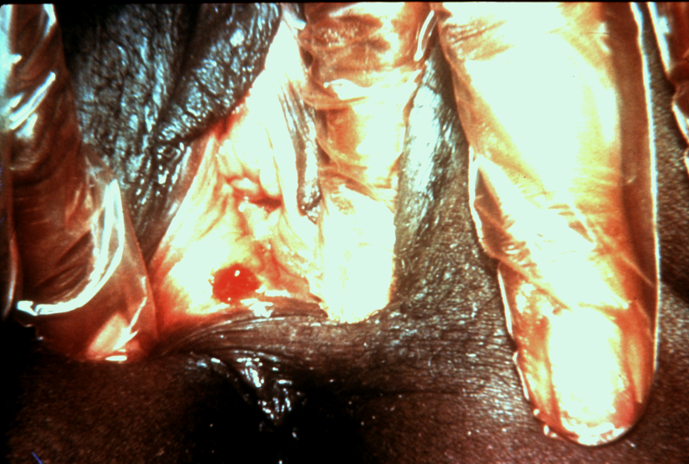
Vaginal opening
Syphilis chancre
Notes:
The image shows a chancre on the female genitalia.

Slide 9
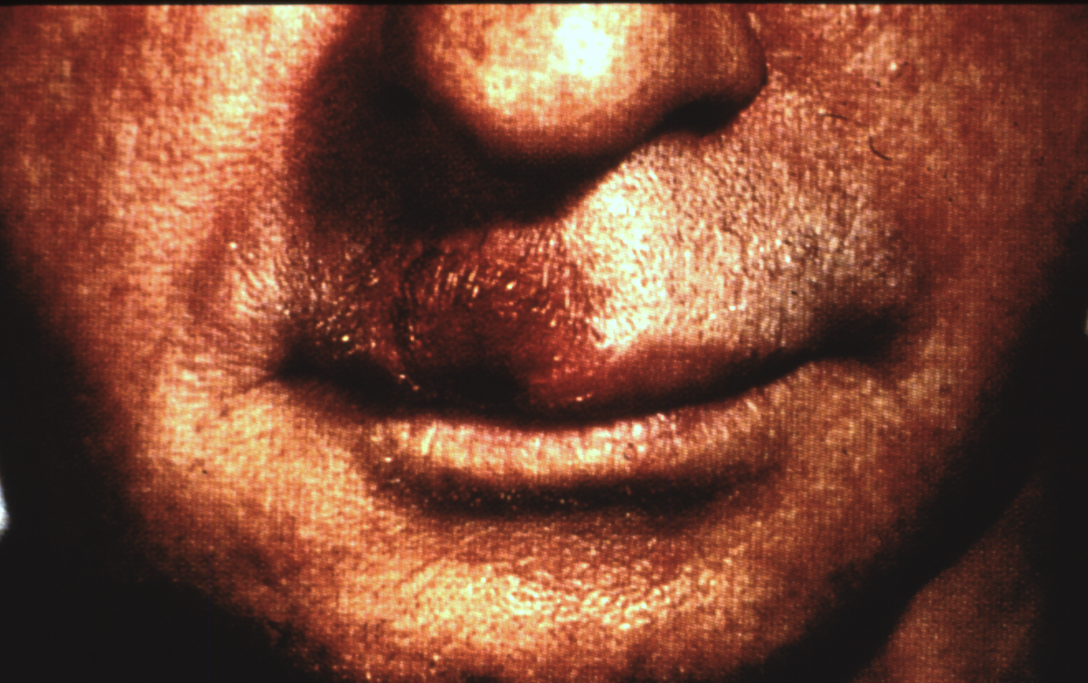
Syphilitic Chancre, Mouth
Notes:
This is a syphilis chancre on a man’s upper lip. These sores are not tender, unlike a herpes sore of the same size. This man could transmit syphilis through oral sex. This slide helps illustrate that a variety of STIs can be transmitted from genitals to mouth or from mouth to genitals. However, there is also the potential to transmit an infection to a partner through an STI that is not visible (i.e., herpes, HPV).

Slide 10
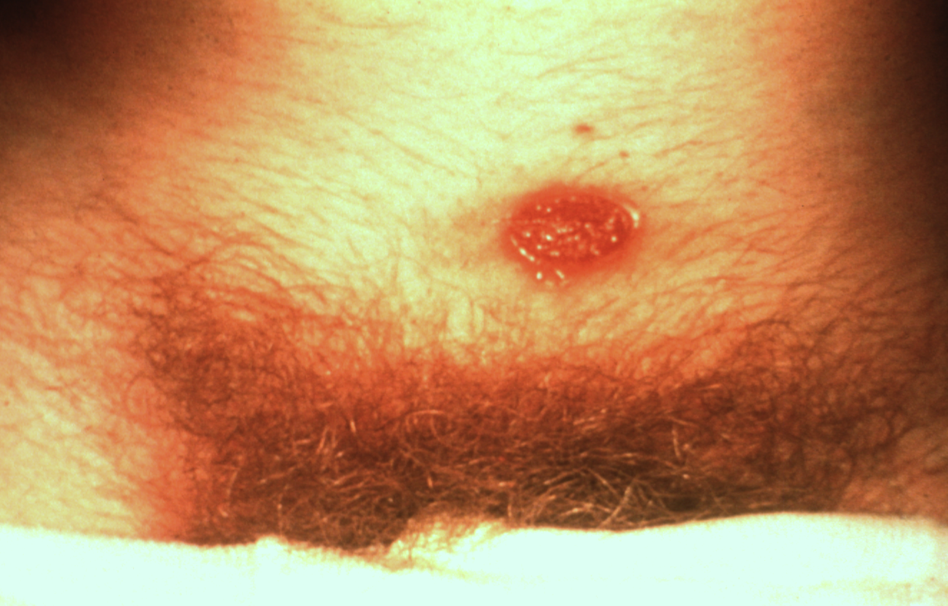
Syphilitic Chancre, Female Abdomen
Notes:
This person has a chancre of the skin just above the pubic hair. Obviously, a condom would not protect another partner from this infection. Such an infection may have resulted from contact with a partner’s syphilitic warts (condyloma latum), which are not necessarily in the genital area. Thus, this case of syphilis could have been acquired or could be passed without any penetrative sex. Herpes and HPV can be transmitted in this same way, either because of contact with STI sores or sexual secretions that are infected with STI viruses.

Slide 11
Syphilitic Chancre, Male
Syphilis chancre
Notes:
This syphilis ulcer is generally painless. This man’s chancre is the initial infection.
He was wearing a condom when he had intercourse with a woman who was infected with syphilis. The condom did not make sex safe for him; he came into contact with syphilis anyway.
He thought he was protected, but he was not.
At this point in the infection, if he has sex with someone else, that person would not be protected – even if he were wearing a condom.
This man’s infection can be used to illustrate one way herpes and HPV can infect another person even when a condom is used properly.

Slide 12
Syphilis and MSM
Syphilis cases among MSM are characterized by high rates of HIV co-infection and high-risk sexual behaviors.
Among 2016 P&S syphilis cases with known HIV-status, 47.0% of cases among MSM were HIV-positive
In 2016 the rate of reported primary and secondary (P&S) syphilis cases among men was 88.9%, much higher than the rate among women.
In 2016, the highest rates were observed among men aged 20-34 years.
Notes:
References:
1. “2016 Sexually Transmitted Diseases Surveillance.” Centers for Disease Control and Prevention, Centers for Disease Control and Prevention, 26 Sept. 2017, www.cdc.gov/std/stats16/Syphilis.htm.

Slide 13
Primary and Secondary Syphilis — Distribution of Cases by Sex and Sexual Behavior, 2016
Notes:
The above chart supports findings that men who have sex with men only (MSM) make up the largest percentage of primary and secondary syphilis.
References:
“2016 Sexually Transmitted Diseases Surveillance.” Centers for Disease Control and Prevention, Centers for Disease Control and Prevention, 26 Sept. 2017, www.cdc.gov/std/stats16/Syphilis.htm.

Slide 14
P&S Syphilis by Age and Ethnicity
The rate of reported P&S syphilis increased in all age groups among those aged 15 years or older, accounting for 79.6% in 2016.
Rates of reported P&S in 2016 were highest among persons aged 20-29.
The rate of reported P&S syphilis cases was highest among Blacks in 2016.
23.1 cases per 100,000 population
4.7 times the rate among whites
.
Notes:
The rate among Native Hawaiians/Other Pacific Islanders (12.9 cases per 100,000 population) was 2.6 times the rate among Whites, the rate among Hispanics (10.9 cases per 100,000 population) was 2.2 times the rate among Whites, the rate among American Indians/Alaska Natives (8.0 cases per 100,000 population) was 1.6 times the rate among Whites, and the rate among Asians (3.9 cases per 100,000 population) was 0.8 times the rate among Whites.
References:
1. “2016 Sexually Transmitted Diseases Surveillance.” Centers for Disease Control and Prevention, Centers for Disease Control and Prevention, 26 Sept. 2017, www.cdc.gov/std/stats16/Syphilis.htm.

Slide 15
How is Syphilis diagnosed?
Syphilis test are used to screen for and/or diagnose infection for bacteria T.pallidum
Several types of tests are available but antibody tests are most commonly used.
Antibody tests detect antibodies in the blood and sometimes in the cerebrospinal fluid (CSF).
Nontreponemal antibody test: not specifically direct against T. pallidum
Treponemal antibody tests: specifically target T. pallidum
Notes:
Nontreponemal tests include Rapid Plasma Reagin (RPR) for measuring the level of antibodies and monitoring treatment of syphilis and Venereal Disease Research Laboratory (VDRL) primarily performed on CSF to help diagnose neurosyphilis.
Darkfield microscopy may be used in the early stages of syphilis when a suspected syphilis sore (chancre) is present. It involves obtaining a scraping of the sore, placing it on a slide, and examining it with a special instrument called a dark-field microscope.
References:
1. “Laboratory Corporation of America®.” LabCorp, www.labcorp.com/help/patient-test-info/syphilis-tests. Accessed October 2017.

Slide 16
How is Syphilis Treated?
Syphilis can be cured effectively with penicillin for all stages of syphilis¹
Damage already done to the body organs cannot be reversed
Repeated tests are important to confirm cure
Only laboratory tests can confirm the presence of syphilis.¹
After successful treatment, reinfection is possible¹
Patients with syphilis should be tested for HIV.²
Notes:
The treatment of syphilis depends on the stage of the disease, symptoms, general health, and allergies.¹
Penicillin is highly effective and is still the treatment of choice for all stages of syphilis. Treatment follow-up is recommended to monitor response to dosage of penicillin and be tested for HIV. ²
The possibility of clinical relapse after syphilis therapy may be slightly higher in HIV-infected patients, the importance of closely following HIV-infected patients with syphilis cannot be overstated.²
References:
Schoenstadt, MD Arthur. “Syphilis Treatment.” EMedTV: Health Information Brought To Life, EMedTV, syphilis.emedtv.com/syphilis/syphilis-treatment-p2.html.
“Syphilis.” Mayo Clinic, Mayo Foundation for Medical Education and Research, 17 Aug. 2016, www.mayoclinic.org/diseases-conditions/syphilis/diagnosis-treatment/drc-20351762.

Slide 17
Reducing Syphilis Risk
Any sexually active person can get syphilis through unprotected anal, vaginal, or oral sex.¹
Consistent condom use (100%) during vaginal sex reduces your risk for syphilis by about 30-50% but doesn’t eliminate risks altogether.^{2,3}
Regular screening is recommended for pregnant women, MSM, presence of a HIV infection, and previously diagnosed syphilis infection.¹
Being in a long term mutually monogamous relationship with a partner who has been tested and has negative test results.¹
Notes:
Depending on how long a pregnant woman has been infected, she may have a high risk of having a stillbirth or of giving birth to a baby who dies shortly after birth. Untreated syphilis in pregnant women results in infant death in up to 40 percent of cases.⁴
In the United States, approximately half of men who have sex with men (MSM) with primary and secondary (P&S) syphilis were also living with HIV. In addition, MSM who are HIV-negative and diagnosed with P&S syphilis are more likely to be infected with HIV in the future.⁴
There is an estimated 2- to 5-fold increased risk of acquiring HIV if exposed to that infection when syphilis is present.⁴
References :
“Sexually Transmitted Diseases (STDs).” Centers for Disease Control and Prevention, Centers for Disease Control and Prevention, 13 June 2017, www.cdc.gov/std/syphilis/stdfact-syphilis.htm.
Crosby RA, Charnigo RA, Weathers C, et al, “Condom Effectiveness in Against Non-viral Sexually Transmitted Infections”, Sexually Transmitted Infections 2012:88(7):484-489.
Koss CA, Dunne EF, Warner L, “ A Systematic review of Epidemiologic Studies Assessing Condom Use and the Risk of Syphilis,” Sexually transmitted Diseases July 2009; Vol 36, No.7
“Sexually Transmitted Diseases (STDs).” Centers for Disease Control and Prevention, Centers for Disease Control and Prevention, 13 Feb. 2017, www.cdc.gov/std/syphilis/stdfact-syphilis-detailed.htm.

Slide 18
Avoiding Syphilis
For unmarried individuals, sexual abstinence is the only practical and certain way to avoid syphilis
For those who choose to be sexually active, a marriage (mutually faithful, life-long relationship with an uninfected sexual partner) is the healthiest choice
Notes:
Abstinence from sexual activity outside of a life-long monogamous relationship is the only practical way to prevent this disease. Faithfulness within marriage is the only certain way for an active person to avoid syphilis. In the field of public health, avoiding the risk of infection is termed primary prevention.

